Slide 1
Chapter 8
Statement-Level
Control Structures

Slide 2
Chapter 8 Topics
Introduction
Selection Statements
Iterative Statements
Unconditional Branching
Guarded Commands
Conclusions

Slide 3
Levels of Control Flow
Within expressions
Among program units
Among program statements

Slide 4
Control Statements: Evolution
FORTRAN I control statements were based directly on IBM 704 hardware
Much research and argument in the 1960s about the issue
  One important result: It was proven that all algorithms represented by flowcharts can be coded with only two-way selection and pretest logical loops

Slide 5
Control Structure
A control structure is a control statement and the statements whose execution it controls
Design question
  Should a control structure have multiple entries?

Slide 6
Selection Statements
A selection statement provides the means of choosing between two or more paths of execution
Two general categories:
  Two-way selectors
  Multiple-way selectors

Slide 7
Two-Way Selection Statements
General form:
if control_expression
then clause
else clause
Design Issues:
  What is the form and type of the control expression?
  How are the then and else clauses specified?
  How should the meaning of nested selectors be specified?

Slide 8
Two-Way Selection: Examples
FORTRAN: IF (boolean_expr) statement
Problem: can select only a single statement; to select more, a GOTO must be used, as in the following example
IF (.NOT. condition) GOTO 20
...
20 CONTINUE
Negative logic is bad for readability
This problem was solved in FORTRAN 77
Most later languages allow compounds for the selectable segment of their single-way selectors

Slide 9
Two-Way Selection: Examples
ALGOL 60:
if (boolean_expr)
then statement (then clause)
else statement (else clause)
The statements could be single or compound

Slide 10
Nesting Selectors
Java example
  if (sum == 0)
if (count == 0)
result = 0;
else result = 1;
Which if gets the else?
Java's static semantics rule: else matches with the nearest if

Slide 11
Nesting Selectors (continued)
To force an alternative semantics, compound statements may be used:
if (sum == 0) {
if (count == 0)
result = 0;
}
else result = 1;
The above solution is used in C, C++, and C#
Perl requires that all then and else clauses to be compound

Slide 12
Multiple-Way Selection Statements
Allow the selection of one of any number of statements or statement groups
Design Issues:
  What is the form and type of the control expression?
  How are the selectable segments specified?
  Is execution flow through the structure restricted to include just a single selectable segment?
  What is done about unrepresented expression values?

Slide 13
Multiple-Way Selection: Examples
Early multiple selectors:
  FORTRAN arithmetic IF (a three-way selector)
IF (arithmetic expression) N1, N2, N3
  Segments require GOTOs
  Not encapsulated (selectable segments could be anywhere)

Slide 14
Multiple-Way Selection: Examples
Modern multiple selectors
  C’s switch statement
switch (expression) {
case const_expr_1: stmt_1;
…
case const_expr_n: stmt_n;
[default: stmt_n+1]
}

Slide 15
Multiple-Way Selection: Examples
Design choices for C’s switch statement
  Control expression can be only an integer type
  Selectable segments can be statement sequences, blocks, or compound statements
  Any number of segments can be executed in one execution of the construct (there is no implicit branch at the end of selectable segments)
  default clause is for unrepresented values (if there is no default, the whole statement does nothing)

Slide 16
Multiple-Way Selection: Examples
The Ada case statement
case expression is
when choice list => stmt_sequence;
…
when choice list => stmt_sequence;
when others => stmt_sequence;]
end case;
More reliable than C’s switch (once a stmt_sequence execution is completed, control is passed to the first statement after the case statement

Slide 17
Multiple-Way Selection Using if
Multiple Selectors can appear as direct extensions to two-way selectors, using else-if clauses, for example in Ada:
  if ...
  then ...
  elsif ...
  then ...
  elsif ...
  then ...
  else ...
  end if

Slide 18
Iterative Statements
The repeated execution of a statement or compound statement is accomplished either by iteration or recursion
General design issues for iteration control statements:
  1. How is iteration controlled?
  2. Where is the control mechanism in the loop?

Slide 19
Counter-Controlled Loops
A counting iterative statement has a loop variable, and a means of specifying the initial and terminal, and stepsize values
Design Issues:
  What are the type and scope of the loop variable?
  What is the value of the loop variable at loop termination?
  Should it be legal for the loop variable or loop parameters to be changed in the loop body, and if so, does the change affect loop control?
  Should the loop parameters be evaluated only once, or once for every iteration?

Slide 20
Iterative Statements: Examples
FORTRAN 90 syntax
DO label var = start, finish [, stepsize]
Stepsize can be any value but zero
Parameters can be expressions
Design choices:
  1. Loop variable must be INTEGER
  2. Loop variable always has its last value
  3. The loop variable cannot be changed in the loop, but the parameters can; because they are evaluated only once, it does not affect loop control
  4. Loop parameters are evaluated only once

Slide 21
Iterative Statements: Examples
FORTRAN 95 : a second form:
[name:] DO variable = initial, terminal [,stepsize]
…
END DO [name]
  Loop variable must be an INTEGER

Slide 22
Iterative Statements
Pascal’s for statement
  for variable := initial (to|downto) final do statement
Design choices:
  Loop variable must be an ordinal type of usual scope
  After normal termination, loop variable is undefined
  The loop variable cannot be changed in the loop; the loop parameters can be changed, but they are evaluated just once, so it does not affect loop control
  Just once

Slide 23
Iterative Statements: Examples
Ada
for var in [reverse] discrete_range loop ...
end loop
A discrete range is a sub-range of an integer or enumeration type
Scope of the loop variable is the range of the loop
Loop variable is implicitly undeclared after loop termination

Slide 24
Iterative Statements: Examples
C’s for statement
  for ([expr_1] ; [expr_2] ; [expr_3]) statement
The expressions can be whole statements, or even statement sequences, with the statements separated by commas
  The value of a multiple-statement expression is the value of the last statement in the expression
There is no explicit loop variable
Everything can be changed in the loop
The first expression is evaluated once, but the other two are evaluated with each iteration

Slide 25
Iterative Statements: Examples
C++ differs from C in two ways:
  The control expression can also be Boolean
  The initial expression can include variable definitions (scope is from the definition to the end of the loop body)
Java and C#
  Differs from C++ in that the control expression must be Boolean

Slide 26
Iterative Statements: Logically-Controlled Loops
Repetition control is based on a Boolean
Design issues:
  Pre-test or post-test?
  Should the logically controlled loop be a special case of the counting loop statement ? expression rather than a counter
General forms:
while (ctrl_expr) do
loop body loop body
while (ctrl_expr)

Slide 27
Iterative Statements: Logically-Controlled Loops: Examples
Pascal has separate pre-test and post-test logical loop statements (while-do and repeat-until)
C and C++ also have both, but the control expression for the post-test version is treated just like in the pre-test case (while-do and do- while)
Java is like C, except the control expression must be Boolean (and the body can only be entered at the beginning -- Java has no goto

Slide 28
Iterative Statements: Logically-Controlled Loops: Examples
Ada has a pretest version, but no post-test
FORTRAN 77 and 90 have neither
Perl has two pre-test logical loops, while and until, but no post-test logical loop

Slide 29
Iterative Statements: User-Located Loop Control Mechanisms
Sometimes it is convenient for the programmers to decide a location for loop control (other than top or bottom of the loop)
Simple design for single loops (e.g., break)
Design issues for nested loops
  Should the conditional be part of the exit?
  Should control be transferable out of more than one loop?

Slide 30
Iterative Statements: User-Located Loop Control Mechanisms break and continue
C , C++, and Java: break statement
Unconditional; for any loop or switch; one level only
Java and C# have a labeled break statement: control transfers to the label
An alternative: continue statement; it skips the remainder of this iteration, but does not exit the loop

Slide 31
Iterative Statements: Iteration Based on Data Structures
Number of elements of in a data structure control loop iteration
Control mechanism is a call to an iterator function that returns the next element in some chosen order, if there is one; else loop is terminate
C's for can be used to build a user-defined iterator:
for (p=root; p==NULL; traverse(p)){
}

Slide 32
Iterative Statements: Iteration Based on Data Structures (continued)
C#’s foreach statement iterates on the elements of arrays and other collections:
Strings[] = strList = {“Bob”, “Carol”, “Ted”};
foreach (Strings name in strList)
Console.WriteLine (“Name: {0}”, name);
The notation {0} indicates the position in the string to be displayed

Slide 33
Unconditional Branching
Transfers execution control to a specified place in the program
Represented one of the most heated debates in 1960’s and 1970’s
Well-known mechanism: goto statement
Major concern: Readability
Some languages do not support goto statement (e.g., Module-2 and Java)
C# offers goto statement (can be used in switch statements)
Loop exit statements are restricted and somewhat camouflaged goto’s

Slide 34
Guarded Commands
Suggested by Dijkstra
Purpose: to support a new programming methodology that supported verification (correctness) during development
Basis for two linguistic mechanisms for concurrent programming (in CSP and Ada)
Basic Idea: if the order of evaluation is not important, the program should not specify one

Slide 35
Selection Guarded Command
Form
  if <Boolean exp> -> <statement>
  [] <Boolean exp> -> <statement>
  ...
  [] <Boolean exp> -> <statement>
  fi
Semantics: when construct is reached,
  Evaluate all Boolean expressions
  If more than one are true, choose one non-deterministically
  If none are true, it is a runtime error

Slide 36
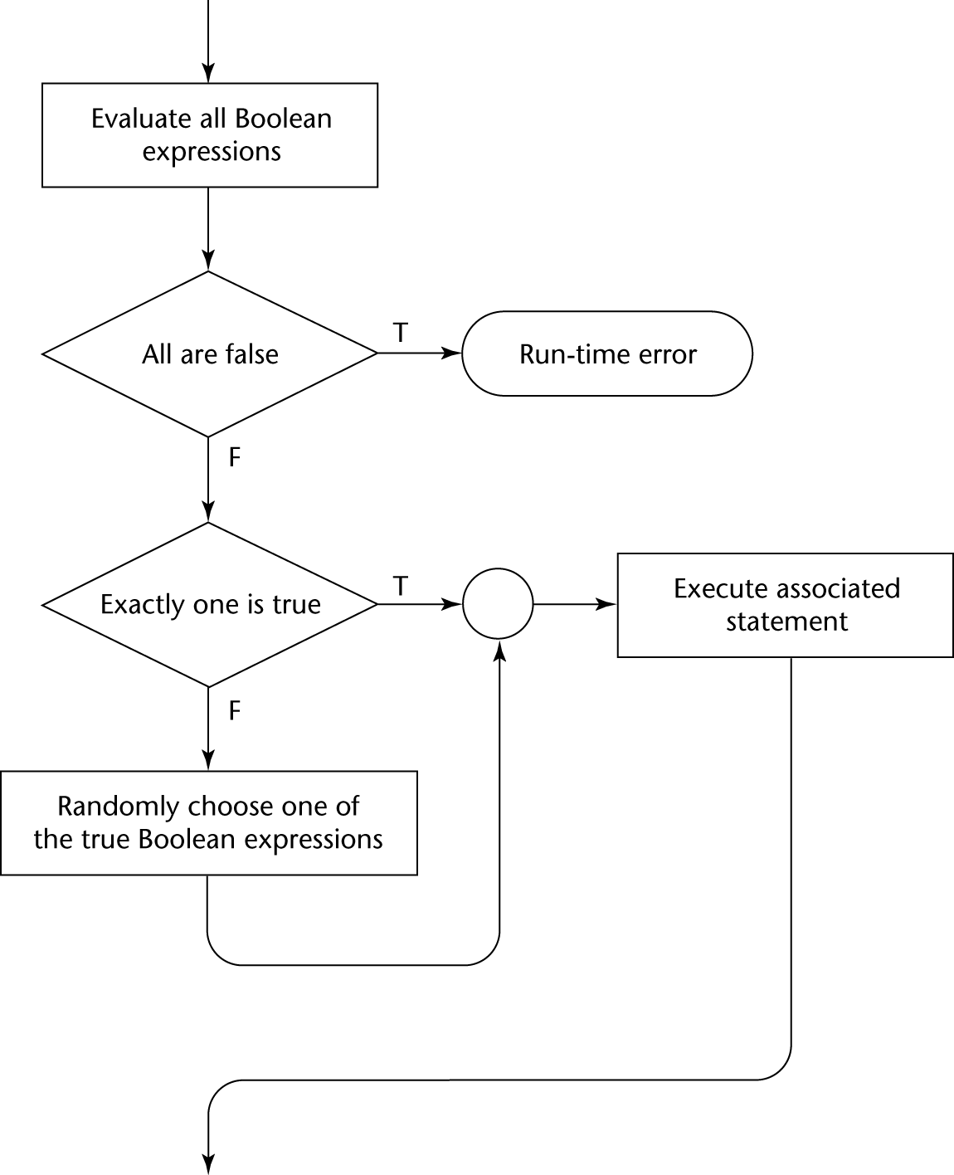
Selection Guarded Command: Illustrated

Slide 37
Loop Guarded Command
Form
  do <Boolean> -> <statement>
  [] <Boolean> -> <statement>
  ...
  [] <Boolean> -> <statement>
  od
Semantics: for each iteration
  Evaluate all Boolean expressions
  If more than one are true, choose one non-deterministically; then start loop again
  If none are true, exit loop

Slide 38
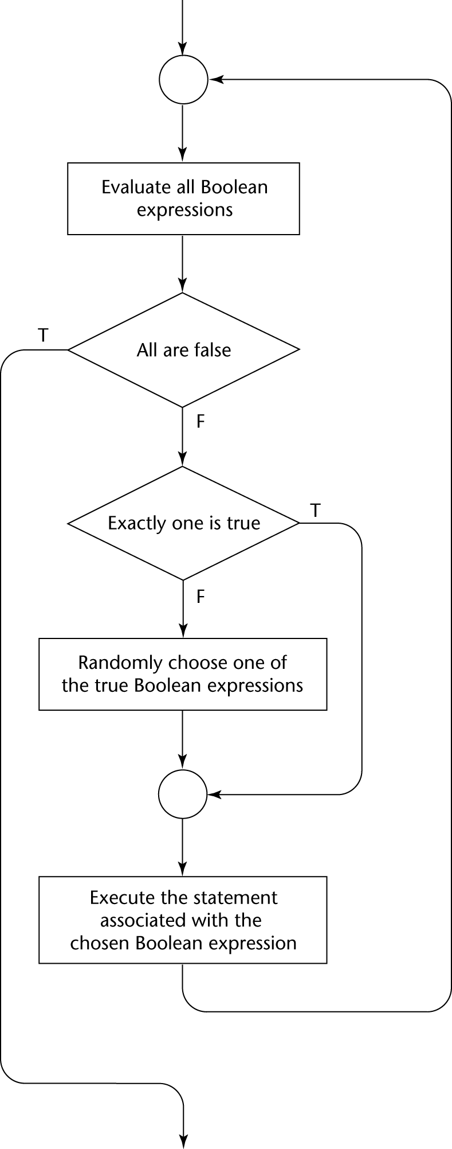
Loop Guarded Command: Illustrated

Slide 39
Guarded Commands: Rationale
Connection between control statements and program verification is intimate
Verification is impossible with goto statements
Verification is possible with only selection and logical pretest loops
Verification is relatively simple with only guarded commands

Slide 40
Conclusion
Variety of statement-level structures
Choice of control statements beyond selection and logical pretest loops is a trade-off between language size and writability
Functional and logic programming languages are quite different control structures

